Slide 1

Predicting the Objective and Priority of Issue Reports in Software Repositories Published in : Empirical Software Engineering (2022)
Maliheh Izadi, Kiana Akbari, Abbas Heydarnoori
COSC 590C – Graduate Seminar
Pragya Bhandari
Department of Computer Science, Mathematics, Physics and Statistics

Slide 2
Contents
Introduction
Motivation
Goals
Dataset
Approach
Results
Comparisons
Conclusion
Notes:
In this presentation, we will go through the following segments for the presentation.

Slide 3
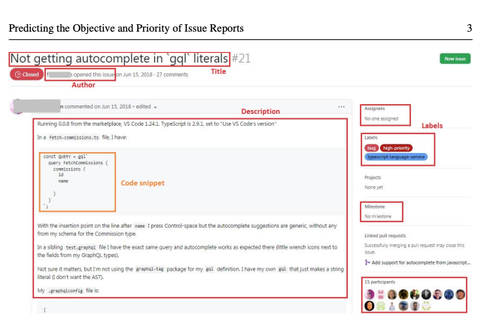
Introduction
Github Issue Tracking system
Issue management
Github Labels – Objective and Priority
Automatic Issue Labelling system
Figure 1: Bug sample from Github. [1]
Notes:
Let me first introduce the concepts that are related to the paper to give a sense of the background of the problem and the research at hand.
The central entity we will be discussing today are software issues. Software issues are one of the most highly analyzed entities in the software development field.
In order to manage them throughout the software development life cycle, they are tracked using issue-tracking systems. When an issue is detected, an issue report is opened and various information related to the bug is added to this report. You can see an example of a bug report in this slide.
GitHub provides an in-built issue tracking system and offers multiple types of categories and labels for better issue management.
The paper by Izadi et al. focused on two main kinds of category criteria – the objective of the issue and the issue priority.
The objective of an issue means what kind of issue is it? Whether it’s a bug, enhancement request, support or documentation type or a feature. These are a few examples of Github issue labels.
The priority of an issue means how severe is the issue and how soon should it be fixed, and whether it should be prioritized over other issues or not.
Through their research, Izadi et al. aimed to build an automatic issue labelling system and performed experiments for two types of classification, one based on objectives and other based on priority.

Slide 4


Motivation
3% repos have labeled issues out of 3 million repos [2]
Engagement rate in high correlation with number of labeled issues
Unlabeled Issues
Notes:
The paper wanted to understand more on Github issue labelling trends. What motivated them?
They found that out of 3 million unforked Github repositiories, only 3% had labelled issues.
In a study, it was reported that issue addressal and the engagement rate was highly correlated to the number of labeled issues in the project.

Slide 5


Motivation
34% bugs are misclassified [3]
Longer time taken to resolve issues
Bug Misclassification
Notes:
Another motivation for them was the problem of misclassification.
In another research, it was reported that 34% of bugs are misclassified in a project.
Misclassification can be detrimental considering how it can mislead developers while solving those issues as well as while prioritizing them. It takes much longer to resolve the issues that have been misclassified.

Slide 6


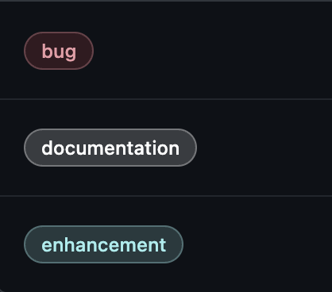

Goals
Issue Classification : Objective
Issue Classification : Priority
Notes:
Given the problems we discussed, Izadi et al. aimed to build two different classification systems for each of the classification criteria. They build Automatic labelling system for Github issues, in terms of issue objective as well as in terms of issue priority.

Slide 7
Dataset
Label | Repositories | Issues
Objective Dataset | 60,958 | 817,743
Priority Dataset | 70 | 82,719
Table 1: Dataset size for each classification task
Notes:
The dataset they used was naturally sourced from GitHub.
For objective classification, they gathered more than 800,000 issues from 60,958 repositories
For priority classification, they had 82,700 issues from 70 repositories.

Slide 8
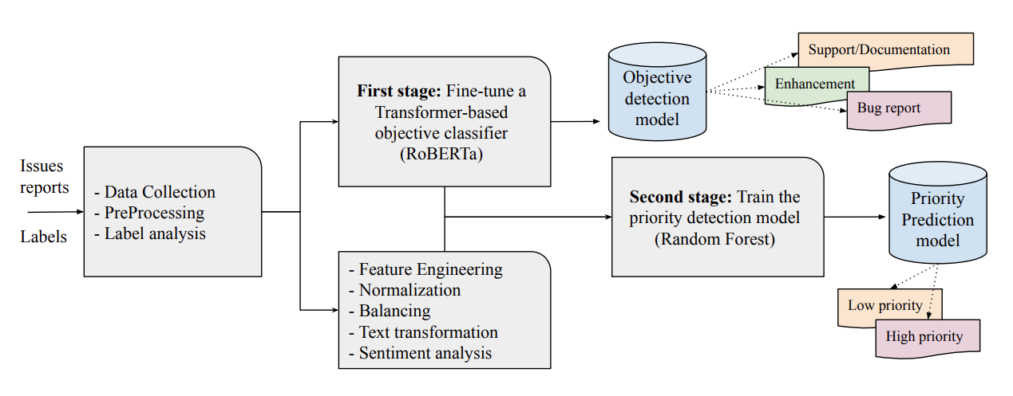
Approach
Figure 2: Approach Overview [1]
Notes:
The authors employed a two-stage approach to predict the objective and priority of issues. The approach consisted of the following steps:
Issue Label Analysis: Initially, issue labels on GitHub were analyzed to determine which labels would be used in the training process.
Data Collection and Preprocessing: Issue report data was collected using the GitHub API. Textual information such as title and description of issue reports, along with all assigned labels, was extracted. A total of 73 types of information were processed and saved from these reports, including author, closer, events, milestones, comments, etc. Rigorous text processing techniques were applied to the data.
Issue Objective Prediction: A transformer-based classifier was trained in this phase to predict the objective of an issue. Specifically, RoBERTa was fine-tuned on their dataset, considering three categories: Bug Report, Enhancement, and Support/Documentation.
Feature Engineering and Model Training: Various NLP and Machine Learning techniques were employed in this phase to train a model based on Random Forest (RF) for predicting priority levels of issues. They used Feature engineering, text normalization and transformation, and Sentiment analysis for the priority prediction model.
Overall, this methodology allowed the authors to efficiently predict both the objective and priority of issues using a systematic approach based on data analysis, NLP techniques, and machine learning models.

Slide 9
Results for Objective based classification
Model | F1-score %
 | Bug | Enhancement | Support
Keyword-based | 49 | 25 | 22
Multinomial NB | 77 | 77 | 47
Bi-LSTM | 74 | 72 | 40
CNN [4] | 77 | 75 | 41
FastText [5] | 80 | 78 | 54
Proposed approach | 85 | 84 | 67
Table 2: Objective detection results and comparisons
Notes:
Now, we will be discussing the results obtained for each of the classifier. For both classification, the authors compared their results with closely related work in the area of bug classification. Izadi et al. compared the objective based classifier approach with other strategies as well as other papers. The results from their approach proved to be far better for each bug class despite some class imbalance in the dataset.

Slide 10
Results for Priority based classification
Model | F1-score %
 | High Priority | Low Priority
Issue Prioritizer [6] | 54 | 57
KNN | 63 | 68
Multinomial NB | 60 | 69
Logistic Regression | 64 | 71
Vanilla RF | 63 | 70
Proposed approach | 72 | 77
Table 3: Priority prediction results and comparisons
Notes:
Similarly for priority based classification, their approach outperformed other contemporary bug classifiers.

Slide 11
Comparisons (Objective based)
Papers | Input | Labels | NLP | Classifier | Results (F1-score)
Ticket Tagger: Machine Learning Driven Issue Classification [5] | Bug title Bug body | Bug Enhancement Question | Bag-of-Words | FastText | 82.63%
GitHub Issue Classification Using BERT-Style Models [7] | Bug title, body Early issue Owner opened Question title | Bug Enhancement Question | -- | RoBERTa + Softmax layer | 86.53%
Predicting the objective and priority of issue reports in software repositories [1] | Bug title Bug description | Bug Enhancement Support | -- | RoBERTa | 82%
Table 4: Comparing the paper with similar papers that worked on Bug classification based on objectives (i.e., with Github issue labels)
Notes:
Now, we will be looking at the relevant chosen papers and comparing them with the paper by Izadi et al. This comparison is only for the objective based classification.
First paper is TicketTagger by Kallis et al. which used Bug title and Bug report body text as their input features. They decided to use three default labels from Github , Bug, Enhancement and Question. They used bag of words approach to process the textual information which is an NLP method that looks at text in an unordered fashion as if words are pulled out in random from a bag. They used FastText classifier which is a text classification and word embedding library developed by Facebook’s AI Research lab. They achieved an overall F1-score of 82.63 using this method.
Second paper is Github Issue Classification Using BERT-Style models by Bhardwaj and Kadam, that used textual features of Bug reports like title and body, as well as other features like whether the issue was one of the early reports of the project, if the issue report was owner opened, and whether the title has a question in it. The labels they used were also Bug, Enhancement and Question. They experimented with other classifiers as well but found the best results using RoBERTa with a linear softmax layer. RoBERTa is a transformer model pretrained to optimize previous implementation of BERT large language model. And, Softmax layer indicates the activation function that is widely used for multi-class output in neural networks.
Finally the paper in question, Predicting the objective and priority of issue reports in software repositories by Izadi et al. chose to use only textual features i.e., bug title and bug description. Their labels were a bit different than the previous two. They selected Bug, Enhancement and Support/Documentation labels. For their classifier, they also reported the best performance by RoBERTa model.
It should be noted that the the last two papers performed multiple experiments and compared their approach with other methods before reporting the ones that worked the best, however, the first paper called TicketTagger only reported the performance of the implemented approach.
Among all the papers here, I would attribute the usage of additional non-textual features with bug title and description, and pretraining the large language model, to getting the highest overall F1-scores by the second paper by Bhardwaj and Kadam.

Slide 12
Comparisons (Priority based)
Papers | Input | Labels | Classifier | Result (F1-score)
Automatic Bug Triage in Software Systems Using Graph Neighborhood Relations for Feature Augmentation [9] | Bug Summary Product Resolution No. of comments | P1 P2 P3 | - Random Forest - SVM | 86.23
Ensemble data reduction techniques and Multi-RSMOTE via fuzzy integral for bug report classification [10] | Bug Summary | Severe Non- severe | SVM | 88
Capbug-a framework for automatic bug categorization and prioritization using NLP and machine learning algorithms [11] | - Bug Summary | P1 P2 P3 P4 | Random Forest | 88.4
Predicting the objective and priority of issue reports in software repositories [1] | Bug title Bug description Sentiment analysis Other non-textual features | High Priority Low Priority | Random Forest | 74.5
Table 4: Comparing the paper with similar papers that worked on Bug classification based on priorities and severity.
Notes:
For priority based classification, we have 3 papers that we have chosen to review and compare with the paper by Izadi et al. In this review I will go column wise instead of row wise to cover them all faster.
It should be noted that the first three papers sourced their data from Bugzilla, while the last paper by Izadi et al. sourced theirs from GitHub issues.
If we compare our selected paper (which is by Izadi et al.) and the second paper as they both have treated this problem as a binary classification, we see that the second paper by Guo et al. performs much better with 88%. However, the differences in their data sources can contribute to these results.
However, if we look at the overall picture, we see that the third paper reports the highest overall F1-score of 88.4%. This could be because while the third paper has taken all priority levels from 1 to 4, the paper by Izadi et al. combined some levels of priority to reduce the labels into a binary problem of high and low priority.

Slide 13

Conclusion
Bug Classification is a diverse problem area.
Bug Classification can be based on varying criteria
RoBERTa showed promise for Objective based classification
Random Forest appropriate for Priority based classification
Notes:
In conclusion, this presentation sheds light on the strategies utilized by researchers in bug classification-related studies. It provides valuable insights into the performance of various classifiers and the significance of accurate issue labeling. The presentation serves as a comprehensive reference for bug classification-related problems
This presentation aimed to compare various solutions proposed by researchers in the context of bug classification, particularly focusing on objective-based classification and priority-based classification. Izadi et al. [10] conducted research to develop automatic bug classifiers for these two problem statements, and their work served as the focal point of comparison. We found that RoBERTa performed exceptionally for objective based classification, while Random forest was the most appropriate for priority based classification.

Slide 14
References
[1] M. Izadi, K. Akbari, and A. Heydarnoori, “Predicting the objective and priority of issue reports in software repositories,” Empirical Software Engineering, vol. 27, no. 2. Springer Science and Business Media LLC, Feb. 01, 2022. doi: 10.1007/s10664-021-10085-3.
[2] J. Cabot, J. L. Canovas Izquierdo, V. Cosentino, and B. Rolandi, “Exploring the use of labels to categorize issues in Open-Source Software projects,” 2015 IEEE 22nd International Conference on Software Analysis, Evolution, and Reengineering (SANER). IEEE, Mar. 2015. doi: 10.1109/saner.2015.7081875.
[3] K. Herzig, S. Just, and A. Zeller, “It’s not a bug, it’s a feature: How misclassification impacts bug prediction,” 2013 35th International Conference on Software Engineering (ICSE). IEEE, May 2013. doi: 10.1109/icse.2013.6606585.
[4] Q. Huang, X. Xia, D. Lo, and G. C. Murphy, “Automating Intention Mining,” IEEE Transactions on Software Engineering, vol. 46, no. 10. Institute of Electrical and Electronics Engineers (IEEE), pp. 1098–1119, Oct. 01, 2020. doi: 10.1109/tse.2018.2876340.
[5] R. Kallis, A. Di Sorbo, G. Canfora, and S. Panichella, “Ticket Tagger: Machine Learning Driven Issue Classification,” 2019 IEEE International Conference on Software Maintenance and Evolution (ICSME). IEEE, Sep. 2019. doi: 10.1109/icsme.2019.00070.
[6] A. B. Dhasade, A. S. M. Venigalla, and S. Chimalakonda, “Towards Prioritizing GitHub Issues,” Proceedings of the 13th Innovations in Software Engineering Conference on Formerly known as India Software Engineering Conference. ACM, Feb. 27, 2020. doi: 10.1145/3385032.3385052.

Slide 15
References
[7] S. Bharadwaj and T. Kadam, “GitHub issue classification using BERT-style models,” Proceedings of the 1st International Workshop on Natural Language-based Software Engineering. ACM, May 21, 2022. doi: 10.1145/3528588.3528663.
[8] J. Wang, X. Zhang, L. Chen, and X. Xie, “Personalizing label prediction for GitHub issues,” Information and Software Technology, vol. 145. Elsevier BV, p. 106845, May 2022. doi: 10.1016/j.infsof.2022.106845.
[9] I. Alazzam, A. Aleroud, Z. Al Latifah, and G. Karabatis, “Automatic Bug Triage in Software Systems Using Graph Neighborhood Relations for Feature Augmentation,” IEEE Transactions on Computational Social Systems, vol. 7, no. 5. Institute of Electrical and Electronics Engineers (IEEE), pp. 1288–1303, Oct. 2020. doi: 10.1109/tcss.2020.3017501.
[10] S. Guo, R. Chen, M. Wei, H. Li, and Y. Liu, “Ensemble Data Reduction Techniques and Multi-RSMOTE via Fuzzy Integral for Bug Report Classification,” IEEE Access, vol. 6. Institute of Electrical and Electronics Engineers (IEEE), pp. 45934–45950, 2018. doi: 10.1109/access.2018.2865780.
[11] H. A. Ahmed, N. Z. Bawany, and J. A. Shamsi, “CaPBug-A Framework for Automatic Bug Categorization and Prioritization Using NLP and Machine Learning Algorithms,” IEEE Access, vol. 9. Institute of Electrical and Electronics Engineers (IEEE), pp. 50496–50512, 2021. doi: 10.1109/access.2021.3069248.

Slide 16
Notes:
To end the presentation I would like to thank and acknowledge my Research supervisor Dr. Gema Rodriguez Perez for her guidance and support. Thank you.

